Slide 1

Spatio-Temporal Fusion in Remote Sensing:
A Novel Approach Leveraging AutoEncoders,
LSTM Network and Maximum Entropy Modeling
Siddharth Kekre
M.S. Computer Science
California State Polytechnic University, Pomona
Fall 2023

Slide 2
Agenda
Introduction
Problem Statement
Literature Review
Proposed Approach
Challenges and Limitations
Conclusion

Slide 3
Introduction
What is Remote Sensing and its importance?
What are Full Spectrum and NDVI Images and why work with NDVI Images?
Understanding Spatio-Temporal Fusion word-by-word.
What are Spatial and Temporal Resolutions?
What is meant by Fusion?
Understanding the Need of Spatio-Temporal Fusion in Remote Sensing.
Understanding Differences between Spatio-Temporal Fusion of Full Spectrum Images v/s NDVI Images.

Slide 4

What is Remote Sensing ?
“Remote sensing is the process of detecting and monitoring the physical characteristics of an area by measuring its reflected and emitted radiation at a distance.”
Source

Slide 5
What is Remote Sensing ?
“Remote sensing is the process of detecting and monitoring the physical characteristics of an area by measuring its reflected and emitted radiation at a distance.”
In Easy Words :
Remote Sensing is the process that aims at determining certain characteristics of an object by observing radiation (usually light) being reflected and/or emitted from it.
Source

Slide 6
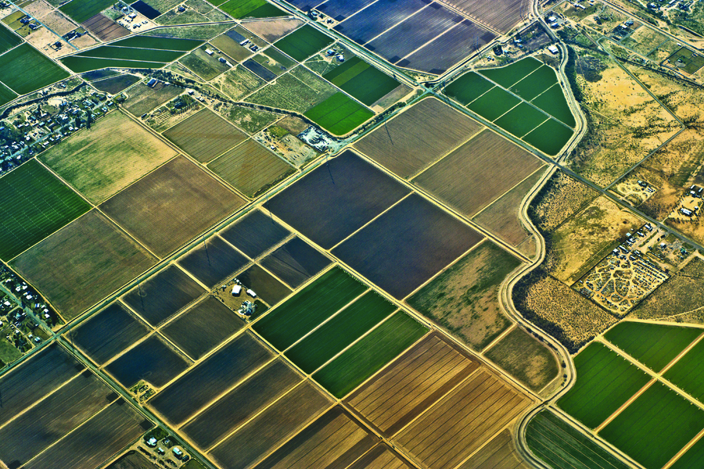
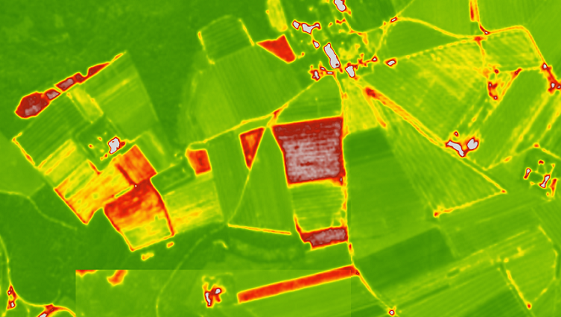
Humans from Airplane
Remote Sensing Satellite
Source
Source

Slide 7
Importance of Remote Sensing ?
Environmental Monitoring:
Climate Change Studies
Vegetation and Wildlife Monitoring
Resource Management:
Agriculture
Forestry
Urban Planning and Development:
Land Use and Land Cover Mapping
Population Density and Growth
Military and Defense:
Surveillance and Reconnaissance
Navigation
Etc.

Slide 8
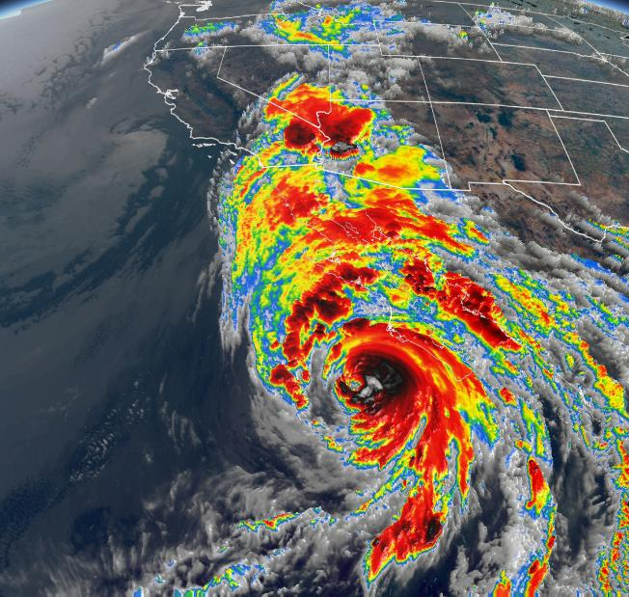
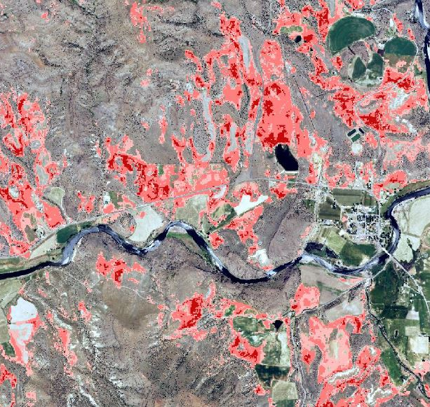
Climate Change Studies
Vegetation and Wildlife Monitoring
Source
Source

Slide 9
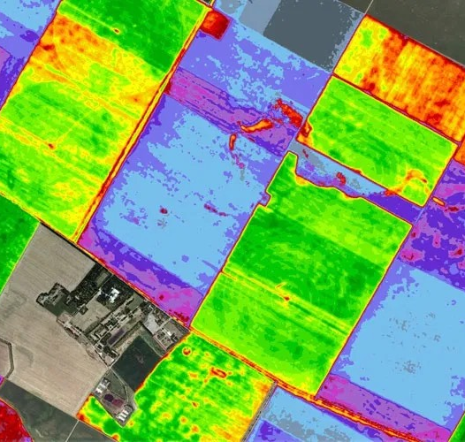
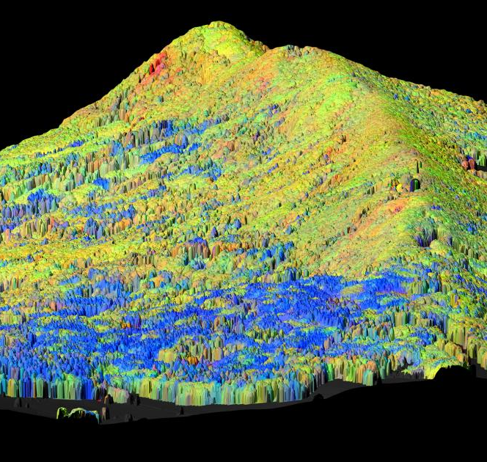
Agriculture
Forestry
Source
Source

Slide 10
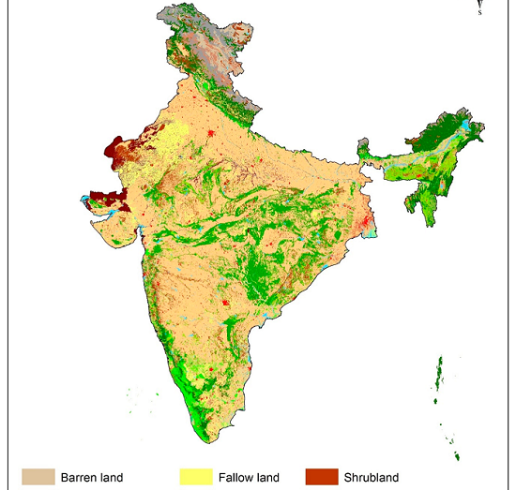
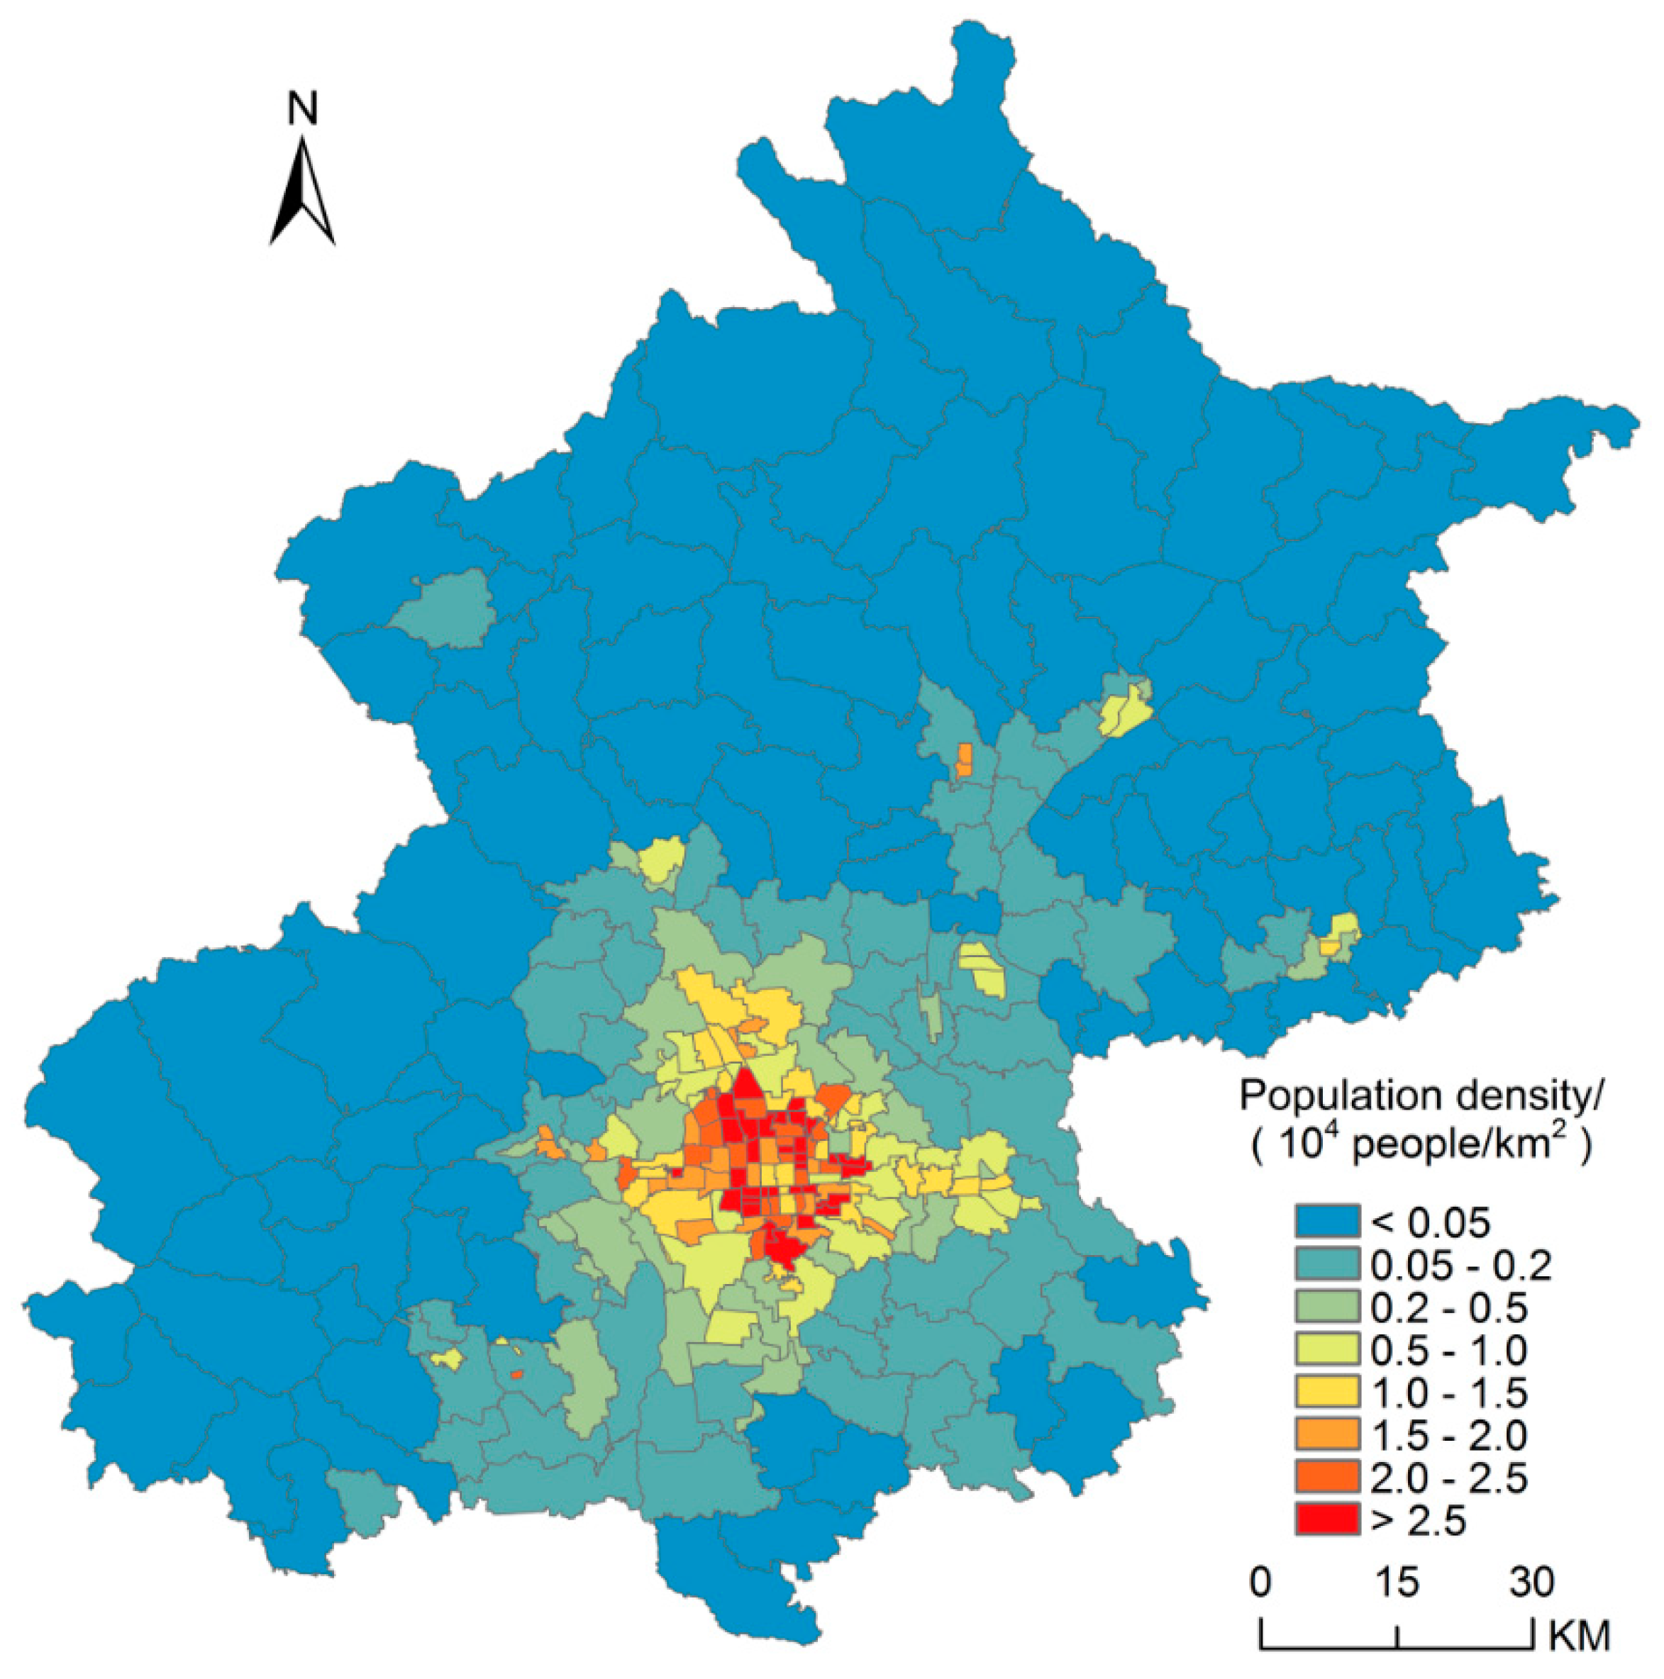
Land Use and Land Cover Mapping
Population Density and Growth
Source
Source

Slide 11

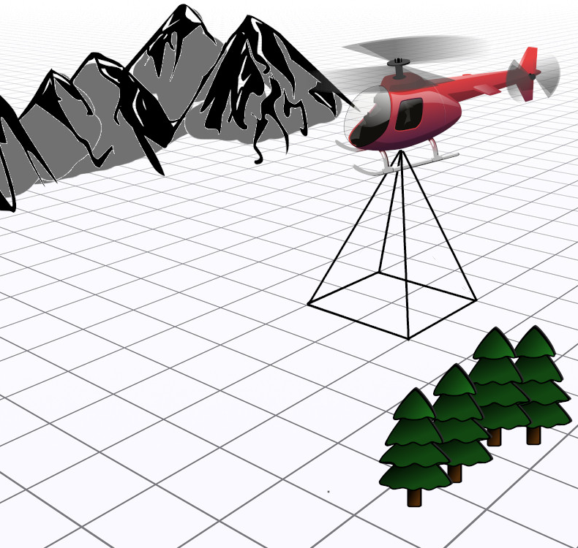
Military Surveillance and Reconnaissance
Navigation
Source

Slide 12
What did All Imagery Data have in Common ?

Slide 13
What did All Imagery Data have in Common ?
All Imagery Data has been Transformed into a Lesser Dimensions while retaining Key Components.

Slide 14
What did All Imagery Data have in Common ?
All Imagery Data has been Transformed into a Lesser Dimensions while retaining Key Components.
In Easy Words : Same Data, Different Color Scheme

Slide 15
Introduction
What is Remote Sensing and its importance?
What are Full Spectrum and NDVI Images and why work with NDVI Images?
Understanding Spatio-Temporal Fusion word-by-word.
What are Spatial and Temporal Resolutions?
What is meant by Fusion?
Understanding the Need of Spatio-Temporal Fusion in Remote Sensing.
Understanding Differences between Spatio-Temporal Fusion of Full Spectrum Images v/s NDVI Images.

Slide 16

Full Spectrum v/s NDVI Images
In Remote Sensing

Slide 17
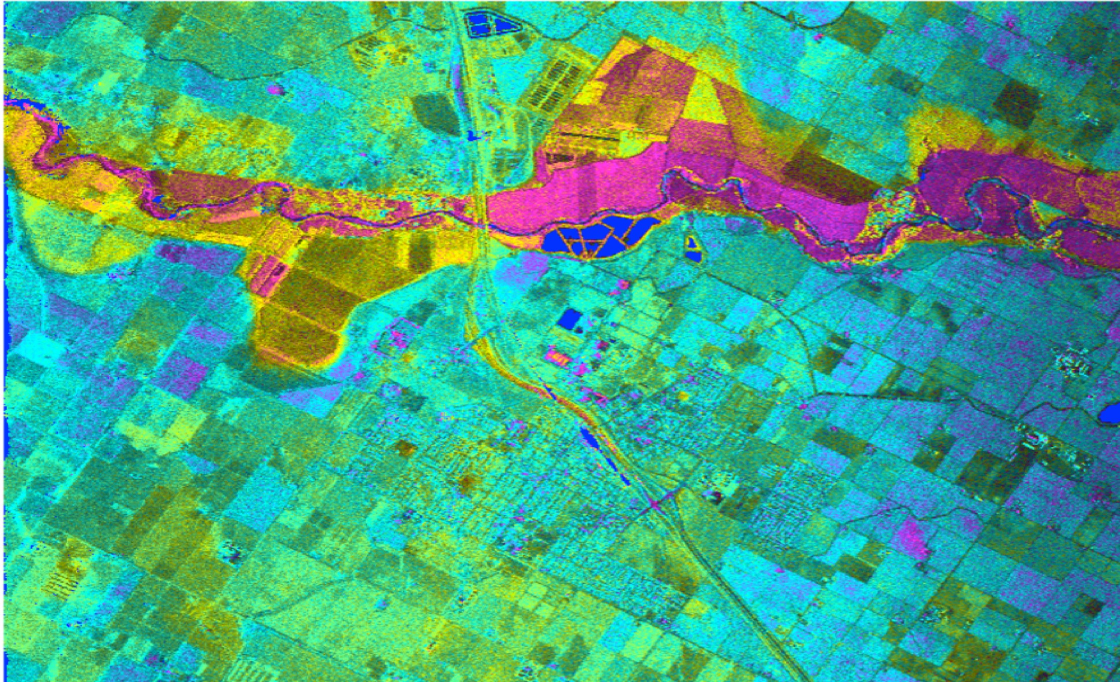
Full Spectrum Remote Sensing Image
Source

Slide 18
Key Differences between
Full Spectrum and NDVI Images
Capturing various bands across the spectrum.
Typically large in size due to the wide range of bands captured.
Can be more expensive due to the need for advanced sensors and processing capabilities.
Suitable for various applications including geology, land cover classification, water quality, and more.
Images Limited to red and near-infrared bands.
Smaller in size as it focuses only on specific bands necessary.
Generally more cost-effective as it requires less advanced technology.
Primarily used in agriculture, forestry, and environmental conservation for monitoring vegetation.
Source

Slide 19
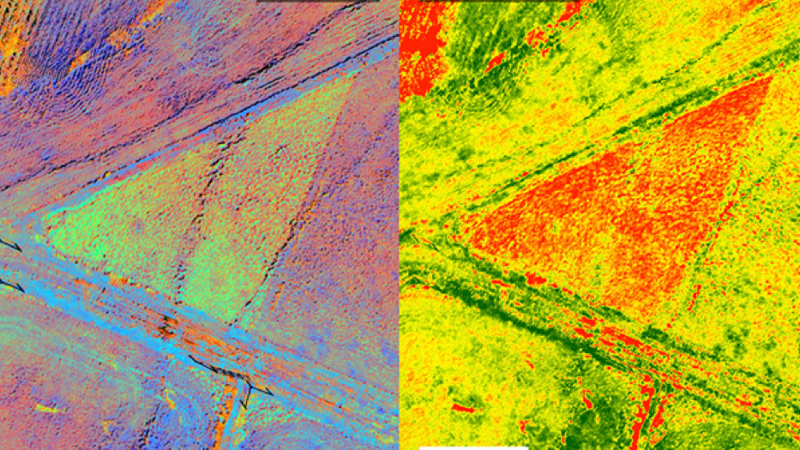
Full Spectrum v/s NDVI
Remote Sensing Image
Source

Slide 20
Why work with NDVI Images ?
NDVI : Normalized Difference Vegetation Index
Specialized for Vegetation Analysis.
Created using Near-Infrared (strongly reflected by vegetation) and Red Light (vegetation absorbs).
Sensitive to Chlorophyll content in Leafs.
Requires less storage space compared to full-spectrum images.

Slide 21
Introduction
What is Remote Sensing and its importance?
What are Full Spectrum and NDVI Images and why work with NDVI Images?
Understanding Spatio-Temporal Fusion word-by-word.
What are Spatial and Temporal Resolutions?
What is meant by Fusion?
Understanding the Need of Spatio-Temporal Fusion in Remote Sensing.
Understanding Differences between Spatio-Temporal Fusion of Full Spectrum Images v/s NDVI Images.

Slide 22

Understanding Spatio-Temporal Fusion
Word-By-Word

Slide 23
What are Spatial and Temporal Resolutions ?
Spatial Resolution :
“It represents the area on the ground that corresponds to a single pixel in the image.”
Temporal Resolution :
“It is the amount of time it takes for a satellite or sensor to revisit and acquire data for the same location on the Earth's surface.”
Source

Slide 24
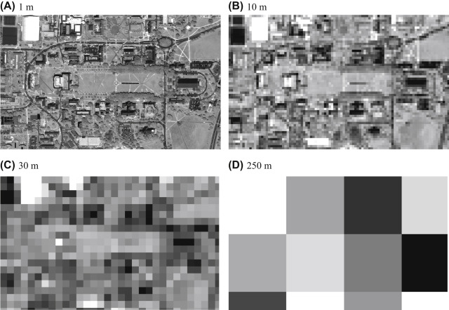
Spatial Resolution :
“It represents the area on the ground that corresponds to a single pixel in the image.”
Source

Slide 25
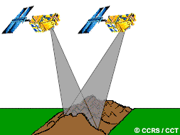
Temporal Resolution :
“It is the amount of time it takes for a satellite or sensor to revisit and acquire data for the same location on the Earth's surface.”
Source

Slide 26
What is Spatio-Temporal ?
“Spatio-temporal" is a comprehensive term that acknowledges the importance of both space and time in understanding complex phenomena.
Analyzing spatio-temporal data allows researchers and professionals to gain deeper insights into the dynamic patterns and processes that unfold in the real world, facilitating more informed decision-making and planning in various fields.
Source

Slide 27
Current Limitations of Remote Sensing Equipment
Remote sensing can be limited by spatial and temporal resolutions, which can affect the level of detail and frequency of data collected, respectively.
The spatial and temporal limitations can limit the usefulness and accuracy of remote sensing data in some applications.
Satellites that capture high-resolution images can typically only pass over the same area every few days or weeks, resulting in low temporal resolution. Contrarily, satellites that pass over the same area multiple times a day can only capture low-resolution images.
Source
Source

Slide 28
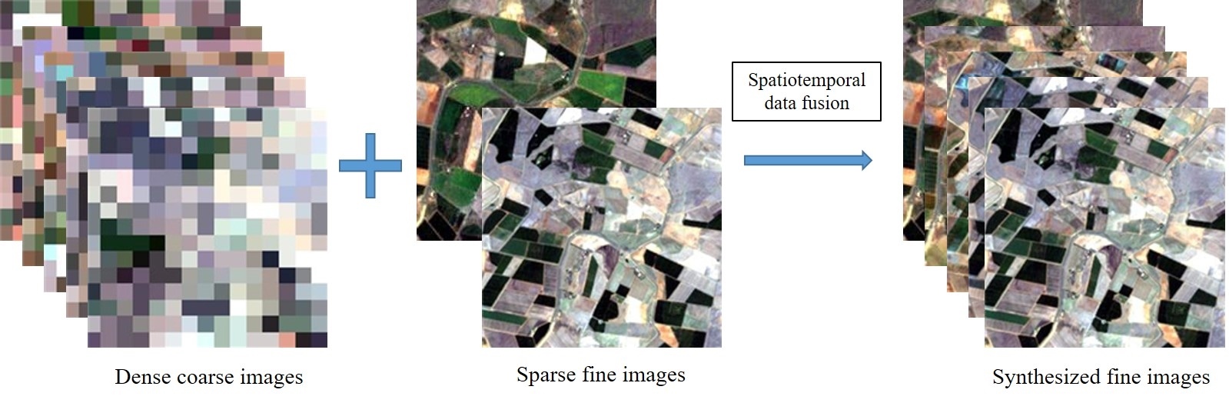
What is meant by Fusion ?
Spatio-Temporal Fusion in the context of Remote Sensing and Geographic Information Systems (GIS) refers to the process of combining data from different sources to improve the spatial and temporal resolution of the resulting dataset.
Source
Source

Slide 29
Introduction
What is Remote Sensing and its importance?
What are Full Spectrum and NDVI Images and why work with NDVI Images?
Understanding Spatio-Temporal Fusion word-by-word.
What are Spatial and Temporal Resolutions?
What is meant by Fusion?
Understanding the Need of Spatio-Temporal Fusion in Remote Sensing.
Understanding Differences between Spatio-Temporal Fusion of Full Spectrum Images v/s NDVI Images.

Slide 30
Understanding the Need of Spatio-Temporal Fusion in Remote Sensing
By integrating data from different sources, spatio-temporal fusion enhances the ability of researchers, analysts, and decision-makers to understand and respond to complex and dynamic phenomena occurring on the Earth’s surface.
Source

Slide 31
Understanding the Need of Spatio-Temporal Fusion in Remote Sensing
Source

Slide 32
Introduction
What is Remote Sensing and its importance?
What are Full Spectrum and NDVI Images and why work with NDVI Images?
Understanding Spatio-Temporal Fusion word-by-word.
What are Spatial and Temporal Resolutions?
What is meant by Fusion?
Understanding the Need of Spatio-Temporal Fusion in Remote Sensing.
Understanding Differences between Spatio-Temporal Fusion of Full Spectrum Images v/s NDVI Images.

Slide 33

Understanding Differences between
Spatio-Temporal Fusion of
Full Spectrum Images v/s NDVI Images.

Slide 34
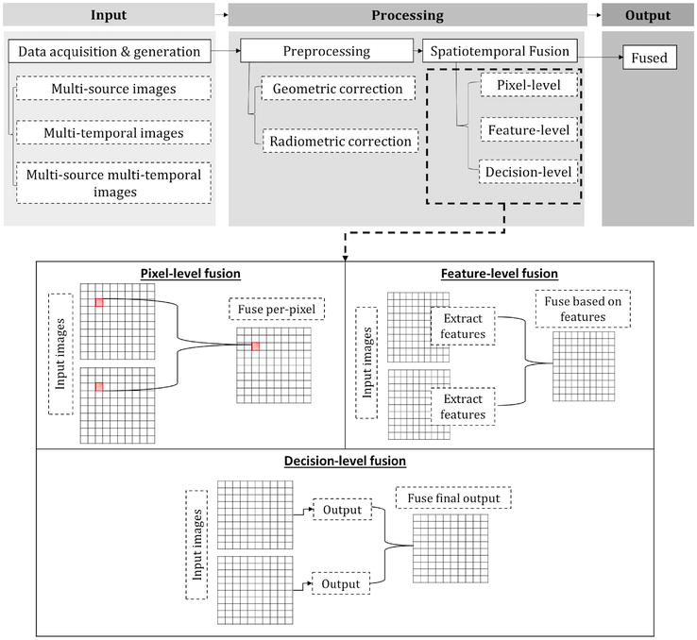
Source

Slide 35
Introduction
What is Remote Sensing and its importance?
What are Full Spectrum and NDVI Images and why work with NDVI Images?
Understanding Spatio-Temporal Fusion word-by-word.
What are Spatial and Temporal Resolutions?
What is meant by Fusion?
Understanding the Need of Spatio-Temporal Fusion in Remote Sensing.
Understanding Differences between Spatio-Temporal Fusion of Full Spectrum Images v/s NDVI Images.

Slide 36
Agenda
Introduction
Problem Statement
Literature Review
Proposed Approach
Challenges and Limitations
Conclusion

Slide 37
Problem Statement
The aim is to create a high spatial and high temporal resolution dataset by combining low-resolution satellite images, specifically Normalized Difference Vegetation Index (NDVI) images.
The objective of this study is to develop a novel approach for Spatio-Temporal Fusion in remote sensing that leverages the capabilities of AutoEncoders, LSTM network, and the Maximum Entropy Modeling.

Slide 38
Agenda
Introduction
Problem Statement
Literature Review
Proposed Approach
Challenges and Limitations
Conclusion

Slide 39
Literature Review
Existing work in the field of Spatio-Temporal Fusion in Remote Sensing.
What is an AutoEncoder ?
What is a LSTM Network ?
What is the Maximum Entropy Modeling (MaxEnt Modeling) ?

Slide 40
Existing work in the field of Spatio-Temporal Fusion in Remote Sensing
STARFM* : Spatial and Temporal Adaptive Reflectance Fusion Model
ESTARFM : Enhanced STARFM
FSDAF : Flexible Spatiotemporal Data Fusion Method
Deep Learning-Based Methods
Source
Source
Source
Source

Slide 41
Existing work in the field of Spatio-Temporal Fusion in Remote Sensing
What if Seasons Change ?
What if there are Clouds ?
Is the method worth the Computational Complexity ?
How much Training Data is Required, and is Available ?
Do Heterogeneous and Homogeneous Environments affect Performance ?

Slide 42
Existing work in the field of Spatio-Temporal Fusion in Remote Sensing
STARFM* : Spatial and Temporal Adaptive Reflectance Fusion Model
ESTARFM : Enhanced STARFM
FSDAF : Flexible Spatiotemporal Data Fusion Method
Deep Learning-Based Methods
Each method has its strengths and limitations, and the choice of method depends on the specific requirements of the application, including the characteristics of the data and the computational resources available.
Source
Source
Source
Source

Slide 43
Literature Review
Existing work in the field of Spatio-Temporal Fusion in Remote Sensing.
What is an AutoEncoder ?
What is a LSTM Network ?
What is the Maximum Entropy Modeling (MaxEnt Modeling) ?

Slide 44
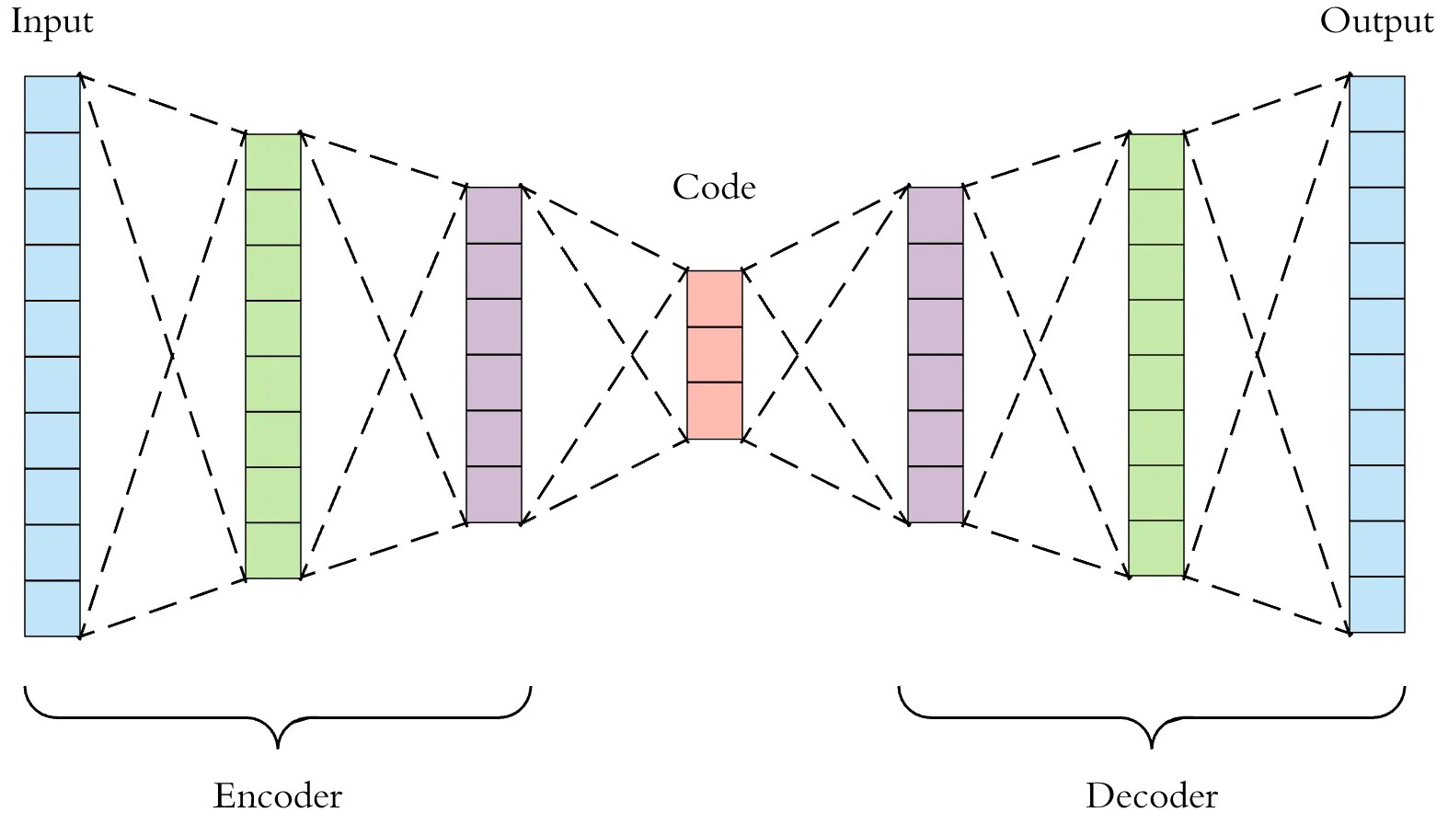
What is an AutoEncoder ?
An AutoEncoder is typically trained to map input data into a lower-dimensional representation and then back into the original data.
AutoEncoder consists of two main parts: an encoder, which compresses the input data into a latent-space representation, and a decoder, which reconstructs the original data from this representation.
Source

Slide 45
Why use AutoEncoder ?
AutoEncoders offer specific advantages for tasks like dimensionality reduction, feature learning, and noise reduction, especially when working with unlabeled data.
Requires Less Training Data to work with.
Source
Consider the Input and Output being the Fine Resolution Image and Latent Space being the Coarse Resolution Image, it could help in enhancing Spatial Resolutions during Fusion Process.

Slide 46
Literature Review
Existing work in the field of Spatio-Temporal Fusion in Remote Sensing.
What is an AutoEncoder ?
What is a LSTM Network ?
What is the Maximum Entropy Modeling (MaxEnt Modeling) ?

Slide 47
What is LSTM Network ?
Long Short-Term Memory (LSTM) network is a type of recurrent neural network (RNN) designed to recognize patterns in sequences of data.
LSTM is widely used for time series forecasting, natural language processing, and other applications involving sequential data.
Source
Why use LSTM Network ?
LSTM Network could help enhance the Temporal Resolution in Fusion Process, also the inherent time-dependent mapping features also provides capabilities to incorporate changes over different seasons.

Slide 48
Literature Review
Existing work in the field of Spatio-Temporal Fusion in Remote Sensing.
What is an AutoEncoder ?
What is a LSTM Network ?
What is the Maximum Entropy Modeling (MaxEnt Modeling) ?

Slide 49
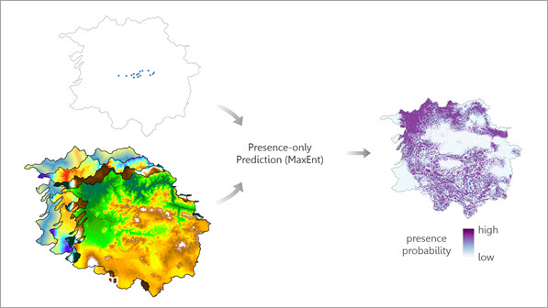
What is Maximum Entropy Modeling (MaxEnt Modeling)?
Maximum Entropy Modeling (MaxEnt Modeling) is a technique used to predict or understand patterns by making the least biased assumptions.
It chooses the model that is most spread out or uncertain (has maximum entropy) while still fitting the known data.
MaxEnt is helpful when we have limited data and don’t want to make strong assumptions about what we don’t know. It provides a flexible and unbiased approach to modeling.
Source

Slide 50
Literature Review
Existing work in the field of Spatio-Temporal Fusion in Remote Sensing.
What is an AutoEncoder ?
What is a LSTM Network ?
What is the Maximum Entropy Modeling (MaxEnt Modeling) ?

Slide 51
Agenda
Introduction
Problem Statement
Literature Review
Proposed Approach
Challenges and Limitations
Conclusion

Slide 52
Proposed Approach
Assumptions of Proposed Approach.
AutoEncoder Component.
LSTM Network Component.
Complete Overview of the Proposed Approach.
Novelty in the Proposed Approach.

Slide 53
Proposed Approach

Slide 54
Assumptions of Proposed Approach
The proposed approach assumes that the input data, both spatial and temporal, are of high quality.
It is assumed that the training data has underlying patterns that can be learned by the AutoEncoder and LSTM Network.
It is assumed that sufficient computational resources are available to carry out the analysis.
Source

Slide 55
Proposed Approach
Assumptions of Proposed Approach.
AutoEncoder Component.
LSTM Network Component.
Complete Overview of the Proposed Approach.
Novelty in the Proposed Approach.

Slide 56
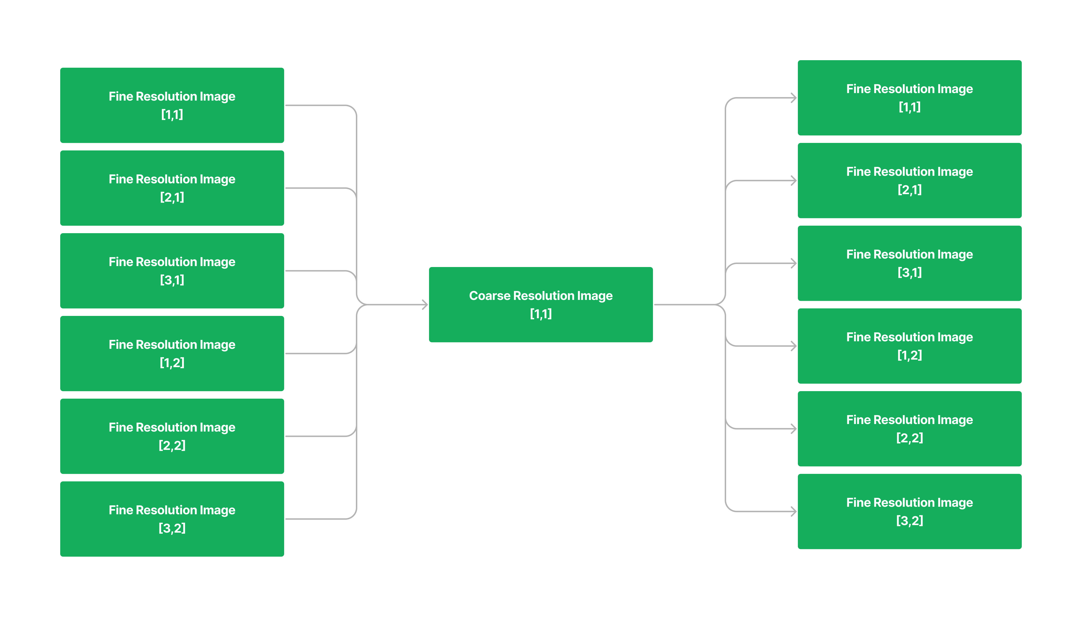
AutoEncoder Component

Slide 57
Proposed Approach
Assumptions of Proposed Approach.
AutoEncoder Component.
LSTM Network Component.
Complete Overview of the Proposed Approach.
Novelty in the Proposed Approach.

Slide 58
LSTM Network Component

Slide 59
Proposed Approach
Assumptions of Proposed Approach.
AutoEncoder Component.
LSTM Network Component.
Complete Overview of the Proposed Approach.
Novelty in the Proposed Approach.

Slide 60
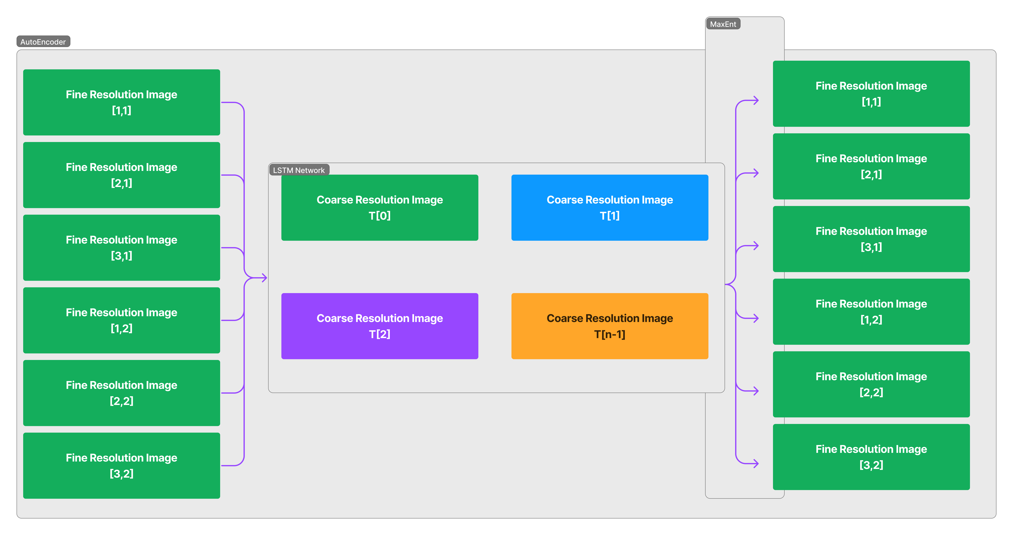

Slide 61
Proposed Approach
Assumptions of Proposed Approach.
AutoEncoder Component.
LSTM Network Component.
Complete Overview of the Proposed Approach.
Novelty in the Proposed Approach.

Slide 62
Novelty in Proposed Approach
The innovative use of the Maximum Entropy Principle to fine-tune the decoder part of the AutoEncoder is a novel aspect. This principle helps in making fewer assumptions about the data and focuses on the most consistent patterns, which is beneficial in achieving a more reliable and robust model.
The proposed approach is designed to account for heterogeneous landforms which many existing techniques struggle with.

Slide 63
Proposed Approach
Assumptions of Proposed Approach.
AutoEncoder Component.
LSTM Network Component.
Complete Overview of the Proposed Approach.
Novelty in the Proposed Approach.

Slide 64
Agenda
Introduction
Problem Statement
Literature Review
Proposed Approach
Challenges and Limitations
Conclusion

Slide 65
Challenges and Limitations
One of the primary challenges is the complexity of learning a mapping function in the AutoEncoder, especially when dealing with high-dimensional data.
Another challenge is specifying appropriate constraints for the Maximum Entropy Principle to ensure that the model doesn't overfit or underfit the data.
Additionally, the computational requirements and training time for deep learning models can be substantial, which may pose challenges in terms of resources and scalability.
Source
Source
Source

Slide 66
Agenda
Introduction
Problem Statement
Literature Review
Proposed Approach
Challenges and Limitations
Conclusion

Slide 67
Conclusion
This project proposal has presented a comprehensive approach for spatio-temporal fusion in remote sensing using AutoEncoder, LSTM Network, and the Maximum Entropy Modeling.
The primary objective of this study is to generate high spatial and high temporal resolution NDVI images by fusing low spatial-high temporal resolution and high spatial-low temporal resolution datasets.
The proposed approach holds significant promise in advancing the field of spatio-temporal fusion in remote sensing. It has the potential to improve the monitoring and analysis of environmental changes, land use, and vegetation patterns.

Slide 68
Agenda
Introduction
Problem Statement
Literature Review
Proposed Approach
Challenges and Limitations
Conclusion

Slide 69
Thank You
Siddharth Kekre
M.S. Computer Science
California State Polytechnic University, Pomona
Fall 2023

